Slide 1
MYSQL

Slide 2
WHAT IS DATABASE?
It is like a container where data can be collected and arranged systematically for easy management and manipulation.
For this work we have software called DBMS (Database Management System).
It is a software where you can Store, Retrieve, Define and Manage our data in a database.

Slide 3
What is RDBMS?
Relational DBMS are mostly used DBMS models because of its easy and flexible nature.
This model is worked on normalizing data in the database. Its gives users the ability to update, query and administer a relational database.
SQL is typically the standard programming language used to access the database.

Slide 4
What and Why is SQL?
SQL is the Standard Language for relational database management.
You can Load, Query and Analyze massive data sets using SQL.
Learning SQL is fun, intuitive and surprisingly easy.
There is always need of employee that know SQL.
Being a database + SQL expert has never ending practical benefits.

Slide 5





Few Common Software of database
NOTE: All are very similar to each other , based on same universal standard, with slight variations in syntax

Slide 6




Popular MySQL Editors
MAC, Windows Linux
Web App(Work only OS
Windows only
MAC only

Slide 7
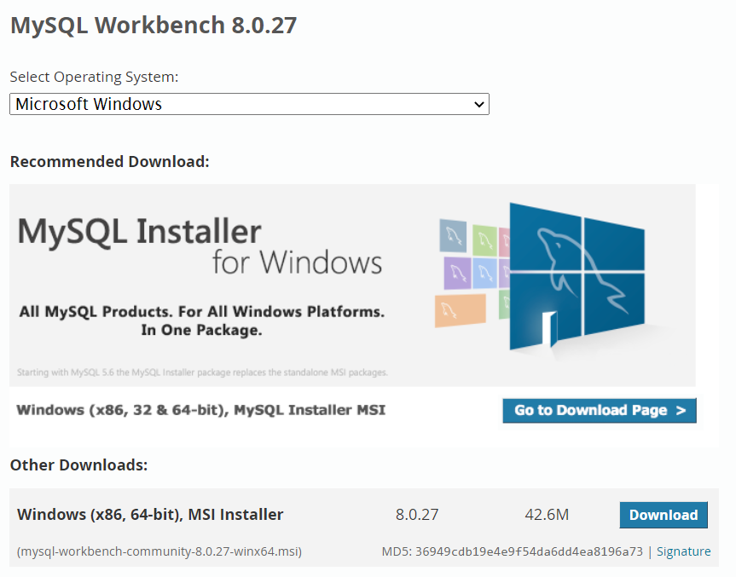
Installation of MYSQL Workbench
https://dev.mysql.com/downloads/workbench/

Slide 8
Types of SQL Queries
DDL – Data Definition Language
It helps us to define the database structure or schema. It is used to
create, modify, and delete the database structure not the data.
List of DDL commands:
Create - To create database or its objects
Drop - Delete objects from database
Alter - Alter the structure of the database
Truncate - Remove all records from a table, including spaces
Comment- Used to add comments
Rename - to rename an object existing in database

Slide 9
Types of SQL Queries
2. DML – Data Manipulation Language
It allows us to manipulate the data present in the database
instances like inserting , modifying , and deleting
List of DML commands:
Insert – Used to insert data into a table
Update – Used to update existing data within a table
Delete – Delete records from a database table
Lock – Table control Concurrency

Slide 10
Types of SQL Queries
3. DQL – Data Query Language
It allows us to performing queries on the data within the schema
objects. So it will fetch the data that we need to see in particular.
SELECT – It is used to retrieve data from database.
4. DCL – Data Control Language
It deals with rights, permission and other controls of the
database system.
GRANT – Gives users access privileges to the database
REVOKE – Withdraws user’s access privileges.

Slide 11
Types of SQL Queries
5. TCL – Transaction Control Language
It deals usually with the transaction within the database.
List of commands:
COMMIT – Commits a Transaction or some process.
ROLLBACK – It rollbacks a few process that done.
SAVEPOINT – Sets a save point within a transaction.
SET TRANSACTION – Specify characteristics for the transaction.

Slide 12
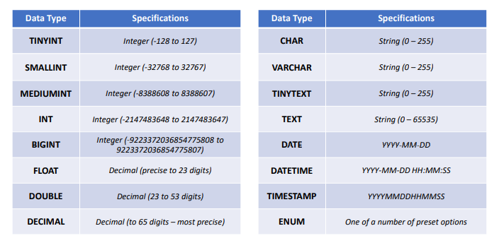
COMMON MySQL DATA TYPES

Slide 13
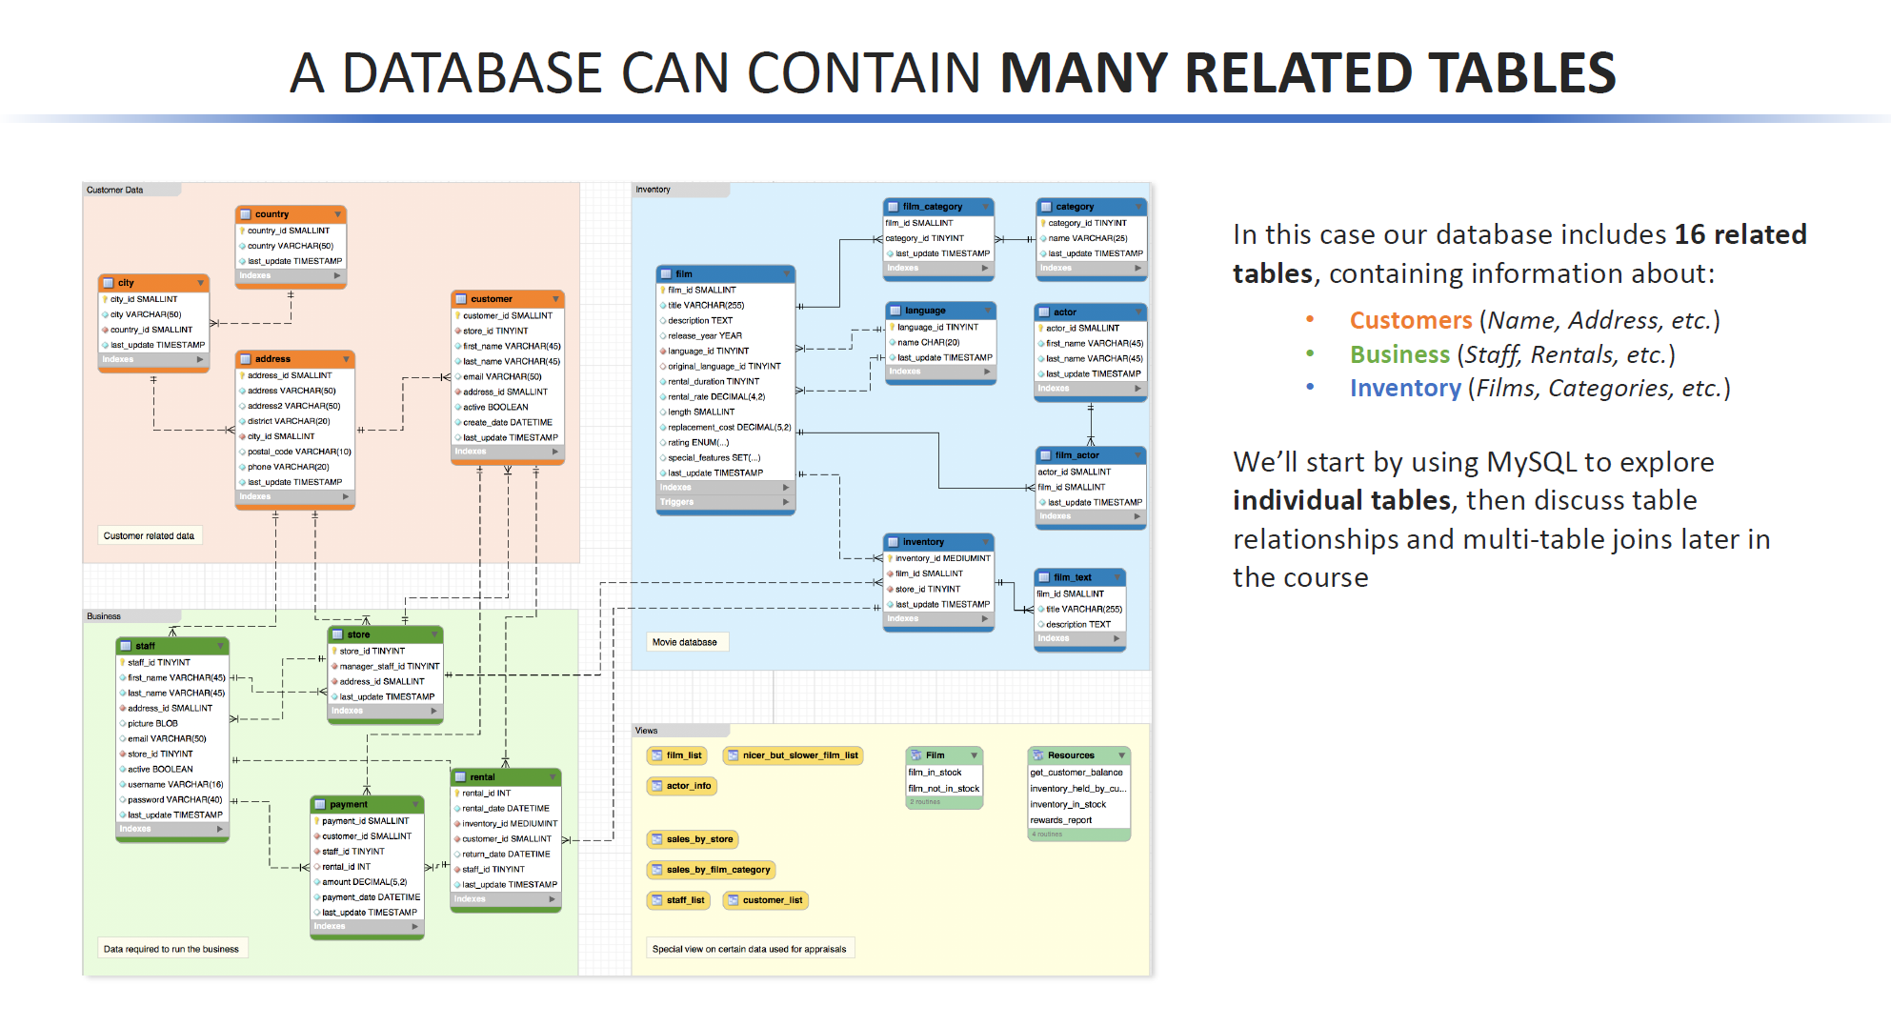

Slide 14
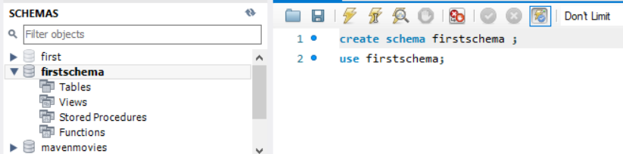
DATABASE ADMINISTRATION
It is about how we administer our database. It uses DDL and DML commands like creating database, altering ,inserting , update and many more.
First we will be seeing how to create our first schema. For this we can be using either UI tools or using code is a matter of preference.
Created Schema
And 2nd line of code is for using that schema
For using any specific schema we have to use command USE SCHEMANAME

Slide 15
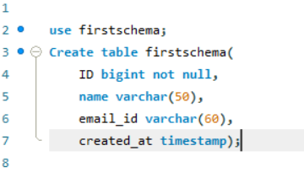
CREATING TABLE - After our schema is created, we can begin populating our schema with tables that will contain records of data.
Creating a new table with code typically involves:
Selecting a schema to add the table to
Giving the new table a name
Specifying which column to include
Setting data formats and types

Slide 16
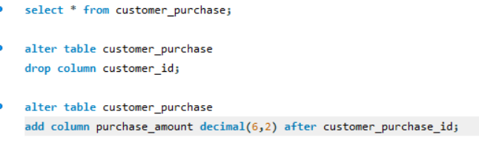
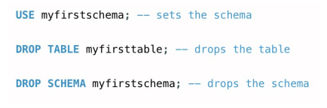
ALTER TABLE AND SCHEMAS
We can use SQL code to alter tables by adding and dropping columns
We specify ALTER TABLE tablename, and then we can either ADD or DROP a column
When we ADD a column, we must also specify its data type
Optionally when we ADD a column, we may specify where it should appear, by using FIRST or AFTER

Slide 17
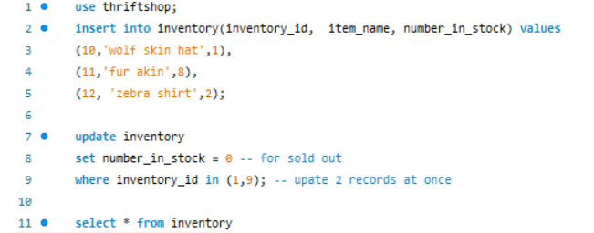
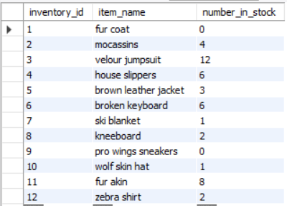
INSERT and UPDATING RECORDS
INSERT and updating using where clause filter(if not it will update all field)

Slide 18
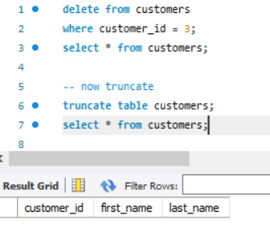
DELETE RECORDS AND TRUNCATE TABLE
Delete from a given data table,we have to specify a WHERE clause, DELETE from will delete all records.
TRUNCATE will want to remove all records from a table but preserve the table structure.It is very similar to using DELETE without a WHERE CLAUSE.

Slide 19
SELECT INTO
The SELECT INTO statement creates a new table and inserts rows from the query into it.
The following SELECT INTO statement creates the destination table and copies rows, which satisfy the WHERE condition, from the source table to the destination table:
SELECT
select_list
INTO
destination
FROM
source
[WHERE condition]
If you want to copy the partial data from the source table, you use the WHERE clause to specify which rows to copy. Similarly, you can specify which columns from the the source table to copy to the destination table by specifying them in the select list.
Note that SELECT INTO statement does not copy constraints such as primary key and indexes from the source table to the destination table.

Slide 20
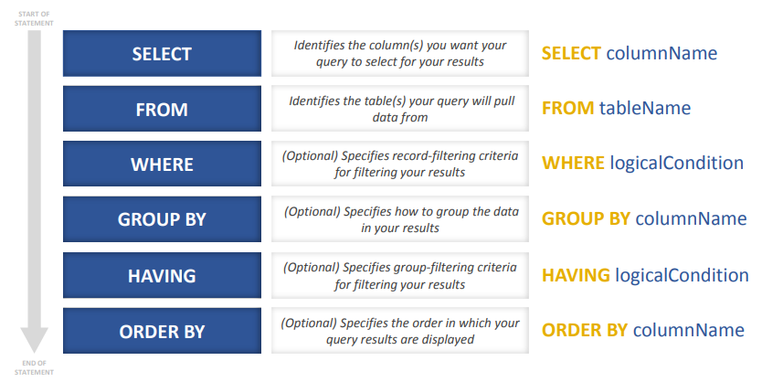
BIG 6 ELEMENTS of a SQL SELECT STATEMENT

Slide 21
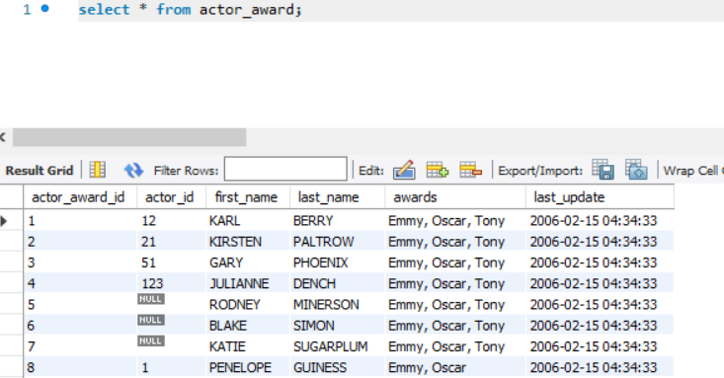
SELECT Statement
SELECT * FROM tablename
SQL all to select all columns from the specified table, using it without WHERE clause will return the entire table
(use semicolon after every query)
Query Result

Slide 22
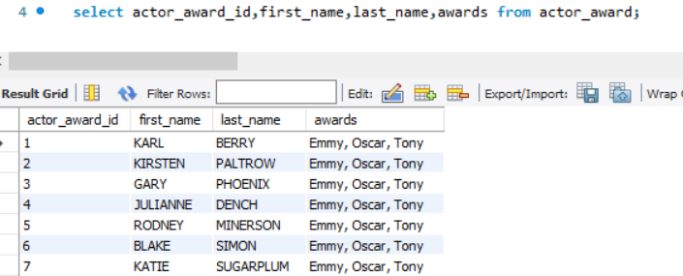
FROM Statement
For seeing only few columns we have to write those specific column names
(use commas for after every column name except the last one)
SELECT actor_award_id,first_name,last_name,awards FROM actor_award;

Slide 23
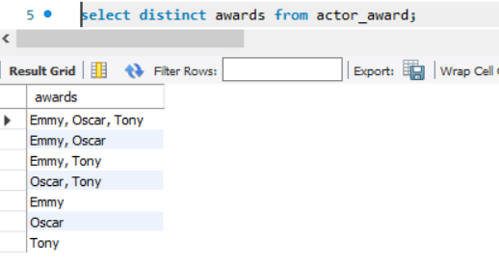
DISTINCT Statement
SELECT DISTINCT column_name from table_name;
Will only show the distinct rows from that table column.
Only 7 rows this time because of distinct feature

Slide 24
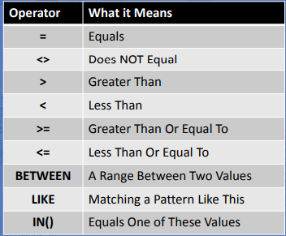
WHERE clause specifies criteria for filtering the records of your result set. It can filter records using any of these logical operators. It will come after FROM clause. Using AND and OR we can use multiple filter at same time. Together using both clauses is a powerful.
WHERE statement

Slide 25
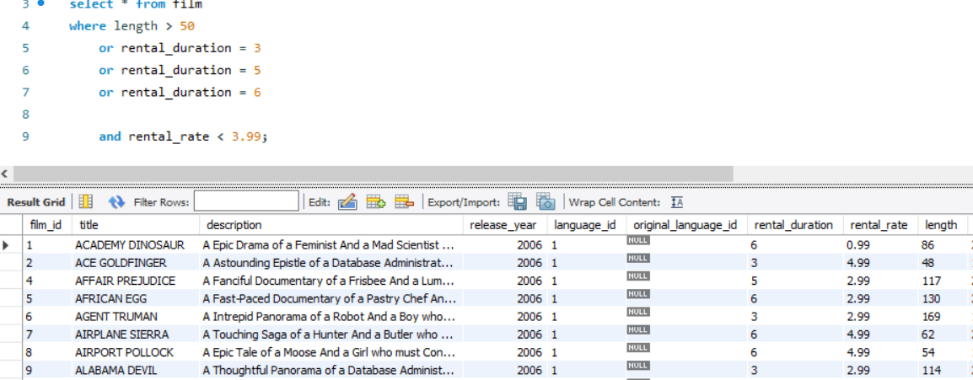
Operator demo with WHERE clause
The sequence of AND and OR matters ,so use according to need.
If you are having multiple OR clause u can use IN.
OR rental_duration in (3,5,6)
Even length is 48 b/c of duration 3 its coming in result

Slide 26
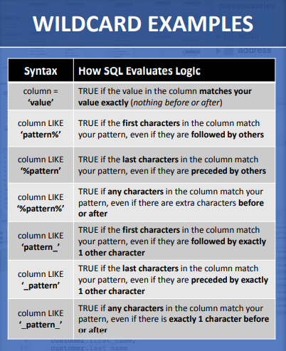
LIKE Operator
Allows you to use pattern matching in your logical operators

Slide 27
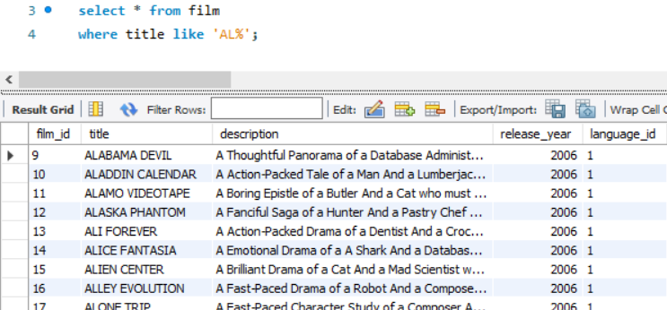
LIKE operator
All the title name which start with “AL” filtered out.

Slide 28
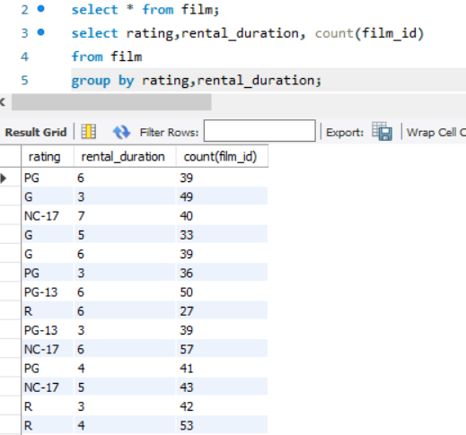
Group BY – It allows us to perform segment analysis on our data at various levels of granularity. You can use multiple columns for grouping if needed. Combining GROUP BY with aggregate functions like COUNT or SUM to specify how values are summarized for each group.

Slide 29
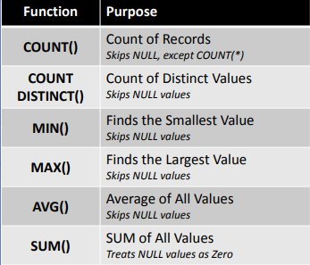
AGGREGATE FUNCTIONS
The powerful functions below can be used GROUP BY to provide group-level summaries.

Slide 30
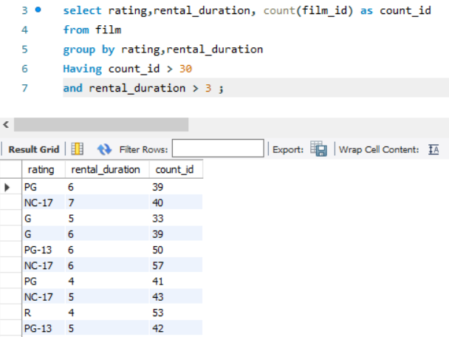
HAVING – It is an optional clause you can use with GROUP BY to limit your result set to group which certain logic criteria. It comes after GROUP BY and before ORDER BY.
Alias to change column name for that query result
The result got grouped with filter in rental_duration and count_id

Slide 31
Difference between WHERE and HAVING
In WHERE clause the records are filtered directly from the table while in HAVING clause the records are filtered from the groupings.
In WHERE we can’t use aggregate functions to filter the records while in HAVING we can use the aggregate functions for filtering the records.
WHERE can be used with DML commands, HAVING is used with SELECT and conjunction with GROUP BY.

Slide 32
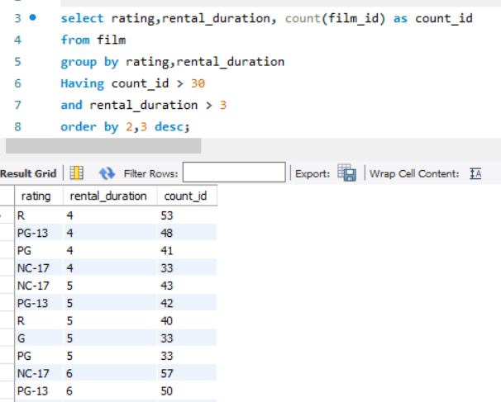
ORDER BY – It let you result sorted. It defaults to ascending order but can be modified to sort in descending order also.
Instead of using column name we can also use column number also
Same query result as last one but sorted rental_duration in ascending order and count_id in descending order.

Slide 33
CONSTRAINTS
NOT NULL – Ensures that a column cannot have a NULL value
UNIQUE – Ensures that all values in a column are different
PRIMARY KEY - A combination of a NOT NULL and UNIQUE
FOREIGN KEY – Prevents actions that would destroys links between tables
CHECK – Ensures the value in column satisfies a specific condition
DEFAULT – Set a default value for a column if no value is specified
CREATE INDEX – Used to create and retrieve data from the database very
quickly

Slide 34
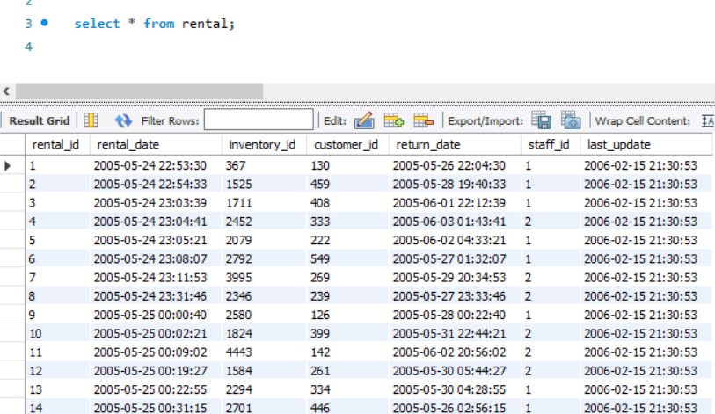
Foreign key for different table
Primary Key
Primary keys cannot contain duplicates and cannot be NULL , Foreign keys can repeat and can be NULL

Slide 35
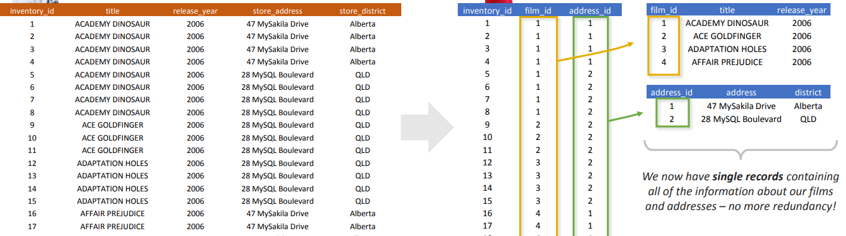
NORMALIZATION
It is the process of structuring tables and columns in relational database to minimize redundancy and preserve data integrity.

Slide 36
JOINS
In SQL, we use JOIN statements to do multiple table querying( i.e. pulling data from multiple tables at once).This can be done using the same field(foreign key) that exist in both the table which we are going to join.
Normalization done also using JOIN.
According to our need we will be using different types of JOIN
When you write queries using multiple tables, you need to specify both the table and column name( i.e. inventory.inventory.id)

Slide 37
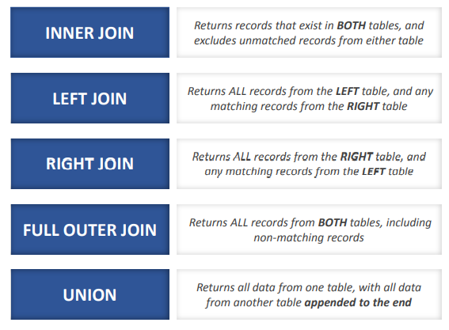
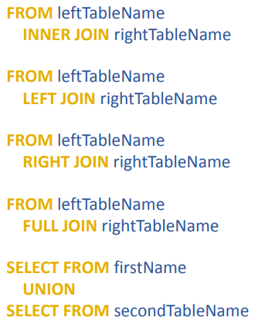
COMMON JOIN TYPES

Slide 38
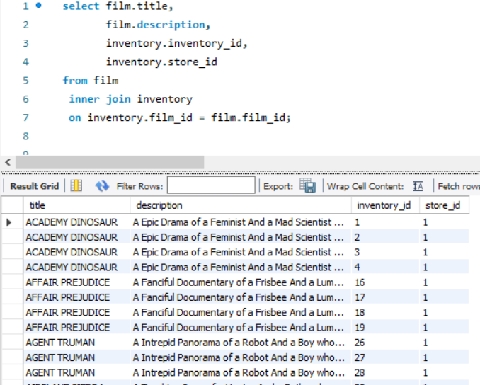
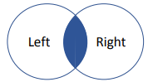
INNER JOIN
This query joins the inventory table with film on film_id column as it exist in both the table.
So the column we want to get only we have to write that column name specifically.
INNER JOIN on venn diagram

Slide 39
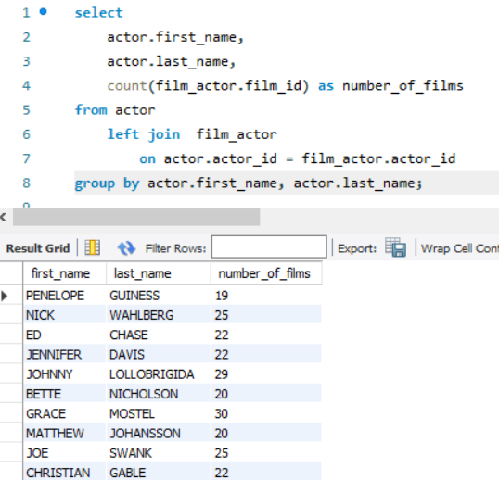
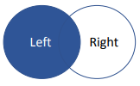
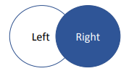
LEFT JOIN and RIGHT JOIN
We use LEFT JOIN here because we want to return all of the actors names , even if they don’t match with any film records i.e. even there is a null value in number of films actor name will be showing not like inner join.
LEFT JOIN on venn diagram
RIGHT JOIN on venn diagram
RIGHT JOIN and LEFT JOIN are just opposite to each other,
It just keep all records from the second(right table).

Slide 40
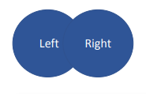
FULL OUTER JOIN
Use a FULL JOIN when you want records from both the tables even when there isn’t a match for the column you are joining on(this may yield lots of records)
It mostly come in handy if you need to merge ALL records from two tables.
FULL OUTER JOIN on venn diagram

Slide 41
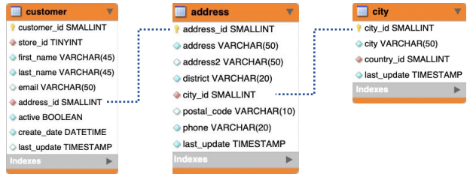
BRIDGING
When we need to connect two tables which do not directly relate.
Here we have no key to connect the customer table directly to city, but we can join customer to address (using address_id), and address to city (using city_id). In this case the address table serves as our bridge.

Slide 42
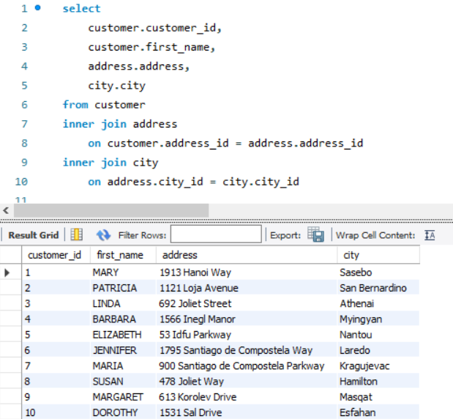

Slide 43
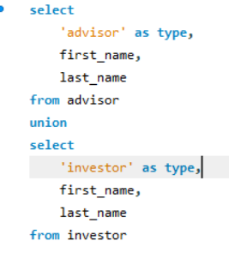
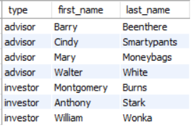
UNION
It allows to combine the result of two or more select statement into a single result set as stacking on each other results.
Each SELECT statement must include the same number of columns, Columns are in same order and stacked columns must share compatible formats
Above the red dotted line different query and below that is different query result

Slide 44
UNION VS UNION ALL
Both are almost same except just one thing that UNION doesn’t allow duplicate values but union all allows duplicate value
UNION ALL most commonly used.

Slide 45
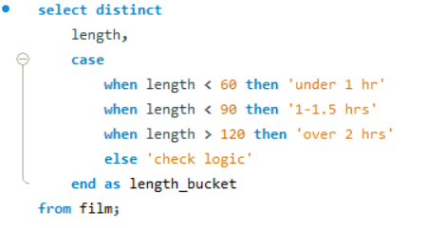
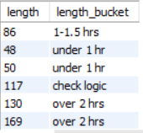
CASE STATEMENTS
CASE Statements allow you to use conditional logic specify how your results should be calculated for various cases
The top WHEN/THEN pair executes first. If true, the CASE is complete. If not, it continues testing each condition until the END is reached
If multiple WHEN/THEN conditions are true, the upper-most condition determines the value, since it’s the first to be evaluated (top to bottom)
If no conditions are satisfied when the CASE reaches the END, a NULL value will be returned
CASE work as same set of logical operator like WHERE

Slide 46
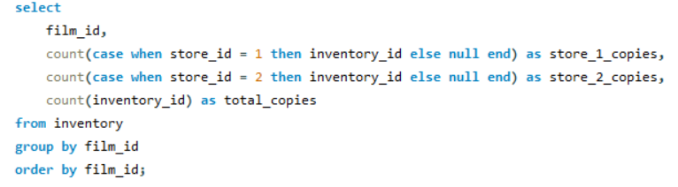
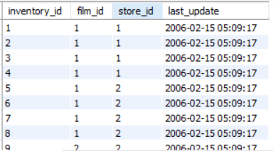
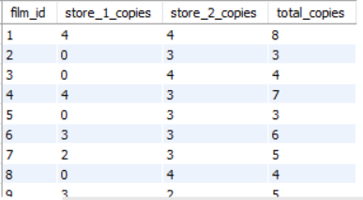
PIVOTING DATA WITH COUNT & CASE
Excel makes it easy to pivot data into columns and rows
CASE PIVOT - Excel’s ability to pivot to columns can be replicated in SQL using COUNT and CASE.
When CASE Pivoting , we use COUNT() and only count records that match a certain criteria.
Using GROUP BY to define your row labels that match a certain criteria.
Before
After

Slide 47
MY SQL functions

Slide 48
Date and Time functions
CURRENT_TIMESTAMP: Returns a datetime value containing the date and time of the computer on which the instance of SQL Server runs. The returned value does not include the time zone offset.
GETDATE : Returns a datetime value containing the date and time of the computer on which the instance of SQL Server runs. The returned value does not include the time zone offset.
GETUTCDATE - Returns a datetime value containing the date and time of the computer on which the instance of SQL Server runs. The function returns the date and time values as UTC time (Coordinated Universal Time)
DATENAME ( datepart , date ) - Returns a character string representing the specified datepart of the specified date.
DATEPART ( datepart , date ) - Returns an integer representing the specified datepart of the specified date.
DAY ( date ) - Returns an integer representing the day part of the specified date.
MONTH ( date ) - Returns an integer representing the month part of a specified date.
YEAR ( date ) - Returns an integer representing the year part of a specified date.
DATEDIFF ( datepart , startdate , enddate ) - Returns the number of date or time datepart boundaries, crossed between two specified dates.
DATEADD (datepart , number , date ) - Returns a new datetime value by adding an interval to the specified datepart of the specified date.
EOMONTH ( start_date [, month_to_add ] ) - Returns the last day of the month containing the specified date, with an optional offset.
ISDATE ( expression ) - Determines whether a datetime or smalldatetime input expression has a valid date or time value.

Slide 49
User defined functions
SQL Server allows us to create our functions called as user defined functions in SQL Server. For example, if we want to perform some complex calculations, then we can place them in a separate function, and store it in the database. Whenever we need the calculation, we can call it.
There are two types of SQL user defined functions:
Scalar Function: It is a function that returns a single value. Generally, we have to define the function body between BEGIN … END block, but for inline scalar function, you can omit them. We can use any SQL data type as the return type except text, image, ntext, cursor, and timestamp.
Table Valued Functions: It is a user defined function in SQL Server that returns a table.Inline Table valued Functions: This function returns a table data type based on a single SELECT Statement

Slide 50
Indexes
SQL indexes are primarily a performance tool,used to retrieve data from a database very fast. Indexing a table or view is, without a doubt, one of the best ways to improve the performance of queries and applications.
It is very useful for connecting the relational tables and searching large tables.A SQL index is a quick lookup table for finding records users need to search frequently. An index is small, fast, and optimized for quick lookups.

Slide 51
Temporary tables
Temporary Tables are a great feature that lets you store and process intermediate results by using the same selection, update, and join capabilities that you can use with typical SQL Server tables.
The temporary tables could be very useful in some cases to keep temporary data. The most important thing that should be known for temporary tables is that they will be deleted when the current client session terminates.
Command- CREATE TEMPORARY TABLE_NAME;

Slide 52
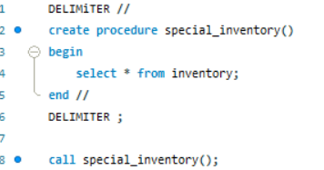
STORED PROCEDURE
MySQL gives us the ability to store and call frequently used queries on the server. These are then referred to as ‘Procedures’, or commonly ‘Stored Procedures’
Benefits include more efficient query writing and query performance, and ability to share complex procedures more easily between Analysts and other database users
For this we put the query in DELIMITER so it will know the procedure query command lines only.
If we later want to drop “DROP PROCEDURe IF EXIST PROCEDURE_NAME “

Slide 53
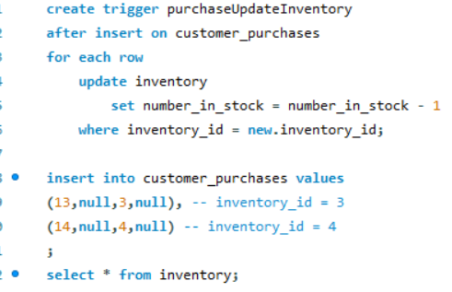
TRIGGERS
MySQL allows us to create Triggers, where we can prescribe certain actions on a table to trigger one or more other actions to occur
We may prescribe that our triggered action occurs either BEFORE or AFTER an INSERT, UPDATE, or a DELETE
Triggers are a very common way to make sure related tables remain in sync as they are updated over time

